Slide 1

BIT MANIPULATION
Programming Club, AKGEC

Slide 2
All data in computer programs is internally stored as bits, i.e., as numbers 0 and 1.
Bitwise operations are therefore faster than other operations resulting in less instances of TLE.
Some applications of bitwise :
Power set representation
Finding Odd occurring number.
Whether a number is Power of 2
Compression and Encryption
And many more ..

Slide 3
Bit Representation

Slide 4
Let’s assume there’s a 3 bit size datatype.
3 bits → 2³ distinct numbers it can possibly represent.
Then these 2³ numbers will have :
(half -ve numbers) + (1 zero) + (rest +ve numbers)
And the digits will range from -2^{n-1} to (2^{n-1} - 1), and here n = 3.
For Bit with most significant bit = 1 :
Number = – (2’s compliment of Bit)
BIT | NUMBER
100 | - 4
101 | - 3
110 | - 2
111 | - 1
000 | 0
001 | 1
010 | 2
011 | 3

Slide 5
Bitwise Operators

Slide 6
And (&) Operator
All bit 1 → 1
Any bit 0 → 0
A | B | A&B
X (24) | 1 | 1 | 0 | 0 | 0
Y (10) | 0 | 1 | 0 | 1 | 0
Z (11) | 0 | 1 | 0 | 1 | 1
X & Y & Z (8) | 0 | 1 | 0 | 0 | 0
0 | 0 | 0
0 | 1 | 0
1 | 0 | 0
1 | 1 | 1

Slide 7
Or (|) Operator
All bit 0 → 0
Any bit 1 → 1
A | B | A | B
X (24) | 1 | 1 | 0 | 0 | 0
Y (10) | 0 | 1 | 0 | 1 | 0
Z (11) | 0 | 1 | 0 | 1 | 1
X | Y | Z (27) | 1 | 1 | 0 | 1 | 1
0 | 0 | 0
0 | 1 | 1
1 | 0 | 1
1 | 1 | 1

Slide 8
Xor (^) Operator
Odd 1 → 1
Even 1 → 0
A | B | A ^ B
X (24) | 1 | 1 | 0 | 0 | 0
Y (10) | 0 | 1 | 0 | 1 | 0
Z (11) | 0 | 1 | 0 | 1 | 1
X ^ Y ^ Z (25) | 1 | 1 | 0 | 0 | 1
0 | 0 | 0
0 | 1 | 1
1 | 0 | 1
1 | 1 | 0

Slide 9
Left Shift (<<) Operator
Shift bits to the left and append 0 at the end.
Equivalent to multiplying number to 2^{k} (if we are shifting k bits).
X (11) | 0 | 0 | 0 | 0 | 1 | 0 | 1 | 1
X << 2 (44) | 0 | 0 | 1 | 0 | 1 | 1 | 0 | 0

Slide 10
Right Shift (>>) Operator
Shift bits to the right and append 0 at the start.
Equivalent to dividing number with 2^{k} (if we are shifting k bits).
X (22) | 0 | 0 | 0 | 1 | 0 | 1 | 1 | 0
X >> 3 (2) | 0 | 0 | 0 | 0 | 0 | 0 | 1 | 0

Slide 11
Operations on Bit

Slide 12
Performing operations on a Bit at position K :
ON Bit
OFF Bit
Toggle Bit
Check Bit
—-----> use ( OR 1 ) mask → | ( 1 << k )
—-----> use ( AND 0 ) mask → & (~ ( 1 << k ) )
—-----> use ( XOR 1 ) mask → ^ ( 1 << k )
—-----> use ( AND 1 ) mask → & ( 1 << k )

Slide 13
Bit Magic

Slide 14
Kth bit is set or not ?
Given a number n and a bit position k, check whether the bit at position k is set or not.
Example : n = 11
1 . If k = 1 → return True
2 . If k = 2 → return False
n (11) | 1 | 0 | 1 | 1
n (11) | 1 | 0 | 1 | 1

Slide 15
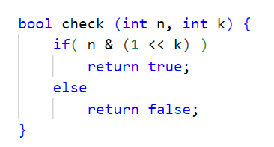
Implementation
Using Check Bit operation & ( 1 << K )

Slide 16
Power of 2 ?
Given a number n, check whether n is a power of 2.
Example : n = 8 ( 2³ )
Observation :
n & ( n - 1 ) —> will toggle Most Significant Bit ( msb ) to Zero.
Since, power of 2 will only have one Set bit. Therefore on performing above operation, the n should reduce to Zero.
n = 8 | 1 | 0 | 0 | 0
n - 1 = 7 | 0 | 1 | 1 | 1

Slide 17
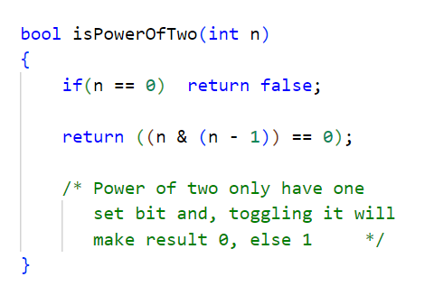
Implementation
Toggling Most Significant Bit using n & (n - 1)

Slide 18
Odd Occuring Number ?
Given an array, find only number in array with odd number of occurrences.
Examples :
Example 1 :
Array1 | 3 | 3 | 2 | 5 | 5 | 6 | 6 | 1 | 1
Output : 2
2. Example 2 :
Array2 | 4 | 3 | 4 | 5 | 5 | 3 | 4 | 3 | 3
Output : 4

Slide 19
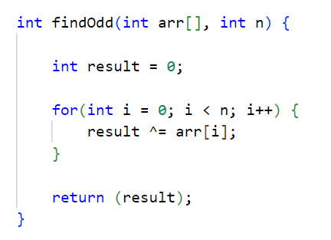
Implementation
Using XOR Property ( A ^ B ) ^ B → A and A ^ 0 → A

Slide 20
Builtin Functions
GCC compiler provides four important builtin functions

Slide 21
X = 5 | 0 | 0 | 0 | 0 | 0 | 1 | 0 | 1
__builtin_popcount ( ) :
Returns number of set bits ( number of one’s ) in an integer.
Example :
int x = 5;
cout<<__builtin_popcount(x);
Output : 2
B. __builtin_parity ( ) :
Odd number of set bits → returns 1
Even number of set bits → return 0
Example :
int x = 5;
cout<<__builtin_parity(x);
Output : 0

Slide 22
X = 8 | 0 | 0 | … | 0 | 0 | 1 | 0 | 0 | 0
C. __builtin_clz ( ) :
Counts Leading Zeros ( clz ) in an integer.
Example :
int x = 8;
cout<<__builtin_clz(x);
Output : 28
D. __builtin_ctz ( ) :
Counts Trailing Zeros ( ctz ) in an integer.
Example :
int x = 8;
cout<<__builtin_ctz(x);
Output : 3

Slide 23
Thank You !

